Slide 1

METAVERSE
By … Abhimanyu Singh
& Aayush Raj Singh…

Slide 2
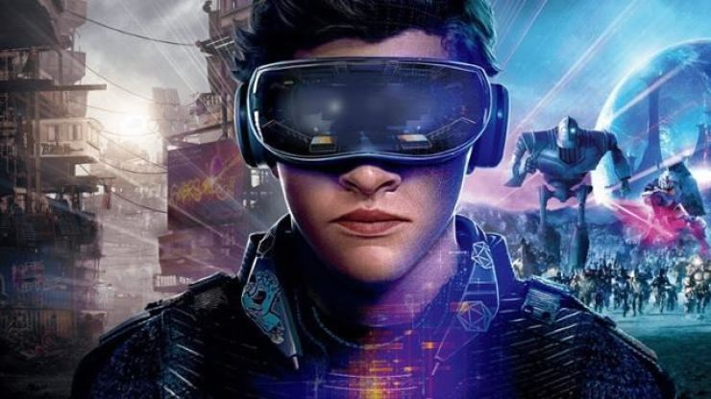
What is metaverse ?
A metaverse is a network of 3-D virtual worlds focused on social connection .
The metaverse can be define as a simulated digital environment that uses augmented reality (AR) , virtual reality (VR) , and blockchain , along with the concept from social media , to create space for rich user interaction mimicking the real world .
This Photo by Unknown Author is licensed under CC BY

Slide 3
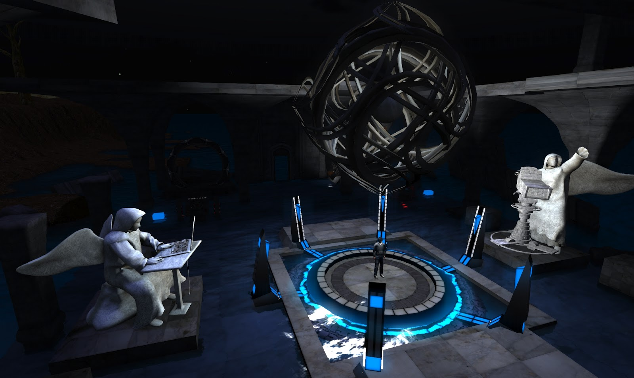
What are the uses of metaverse?
The first promising use case of the metaverse is evident in the possibilities of using the metaverse for unlocking new marketing opportunities.
People can interact and socialize with each other through digital avatars in the metaverse.
The metaverse could also open up new opportunities for creating virtual workspaces.

Slide 4
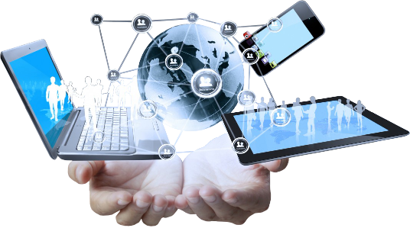
What do you need for metaverse?
A smart phone…..
A computer. ...
A gaming console. ...
A Virtual Reality (VR) headset. ...
Augmented Reality (AR) glasses.

Slide 5
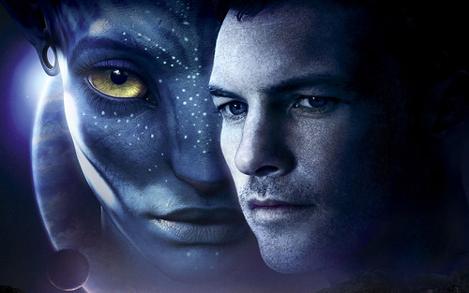
What is avatar in virtual world?
An avatar is a graphical representation of a user or the user's character or persona.
It may take either a two-dimensional form as an icon in Internet forums and other online communities or a three-dimensional form, as in games or virtual worlds.

Slide 6
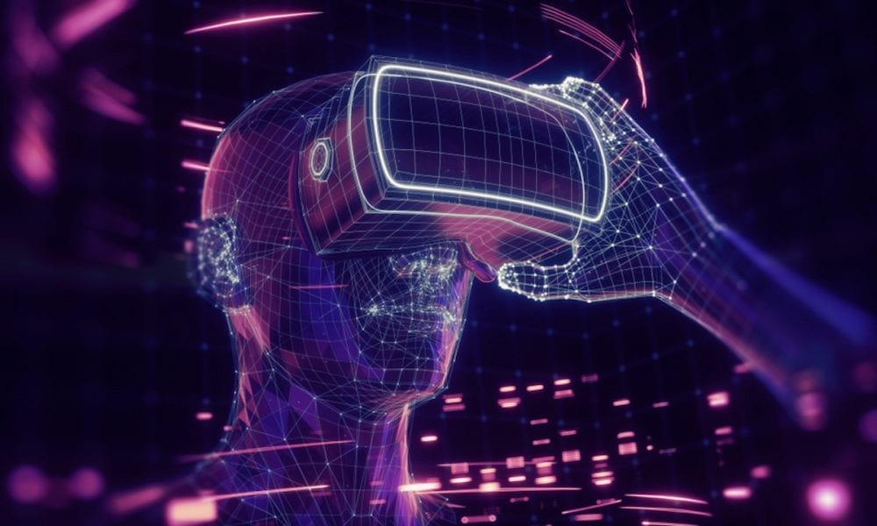
How metaverse changing the world ?
Advertising will move aggressively into the metaverse.
Turning video call into reality.
Education will take place inside the metaverse.
Instantly travel the world inside the metaverse.

Slide 7

METAVERSE IN FUTURE

Slide 8
